Slide 1


Slide 2

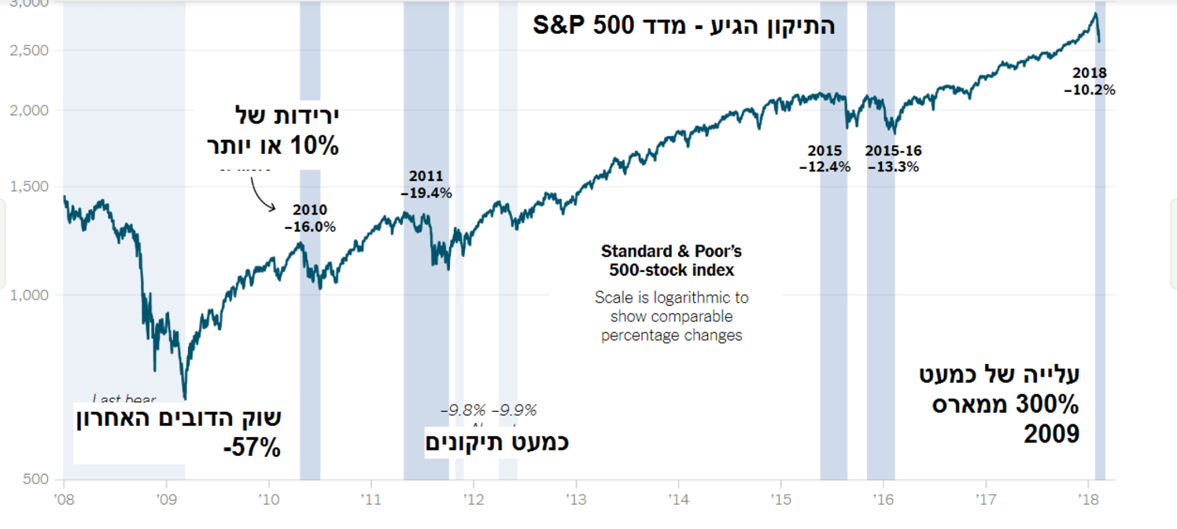
(%) Total Annual Return - S&P500
2008 | 2009 | 2010 | 2011 | 2012 | 2013 | 2014 | 2015 | 2016 | 2017
38.49- | 23.45 | 12.78 | 0 | 13.41 | 29.60 | 11.39 | 0.73- | 9.54 | 19.42

Slide 3

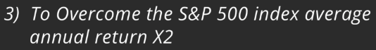

Slide 4
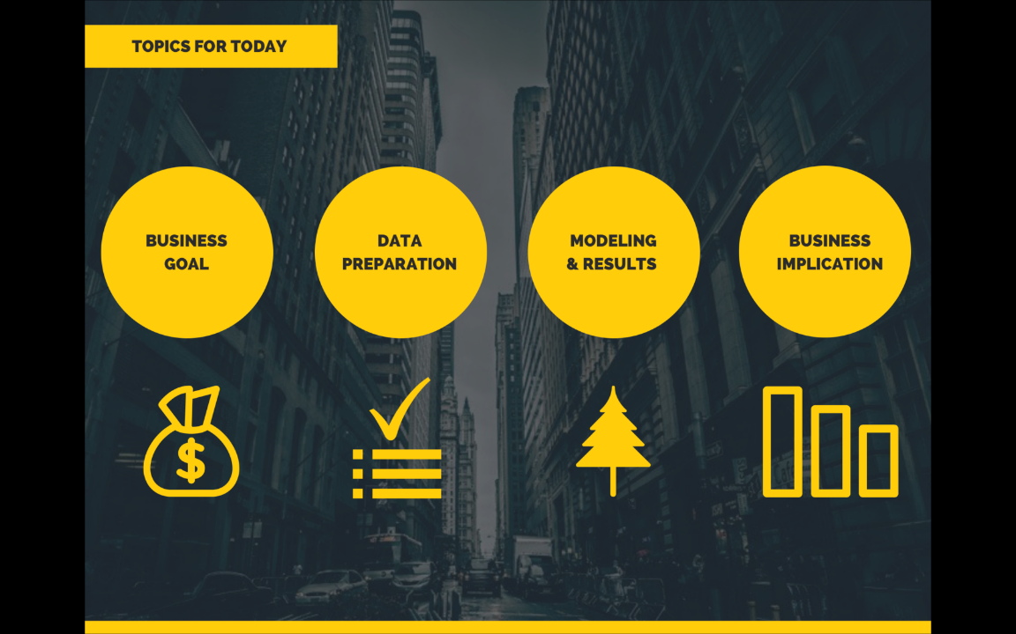

Slide 5
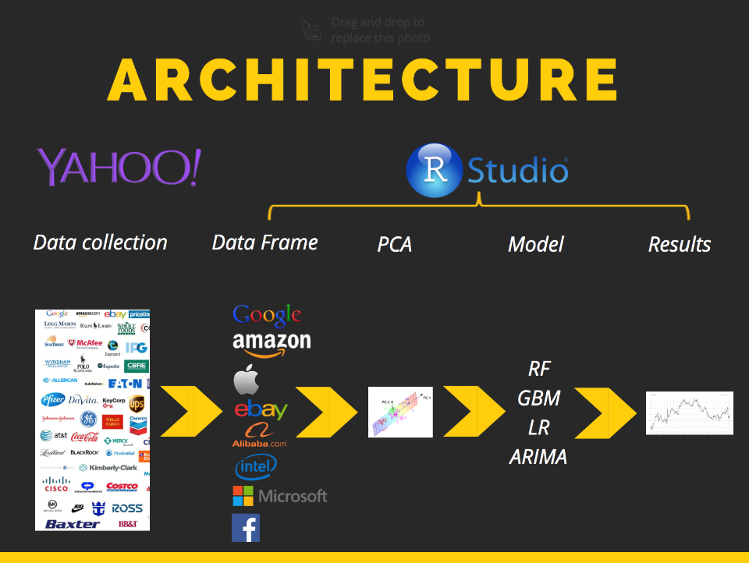

Slide 6


Slide 7
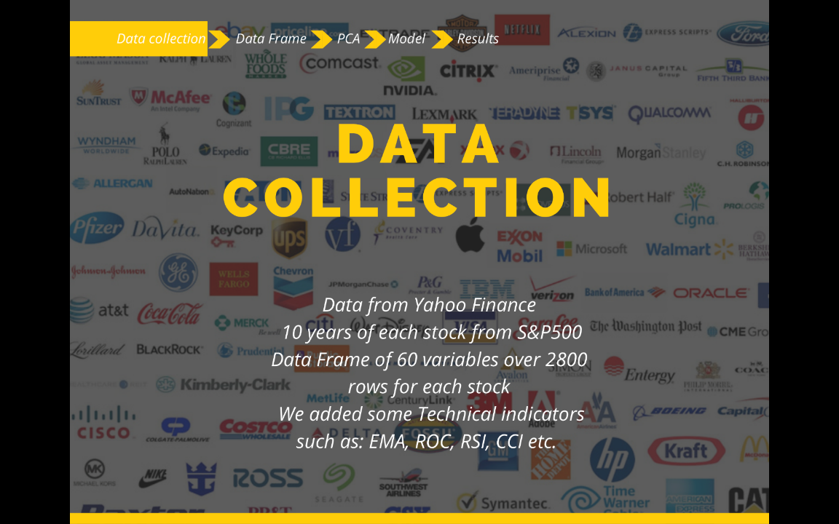
3,600
1,400,000

Slide 8
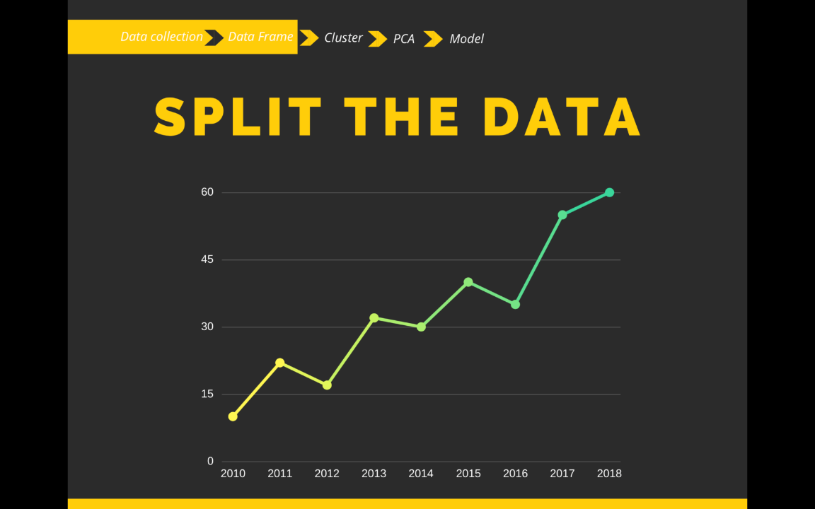
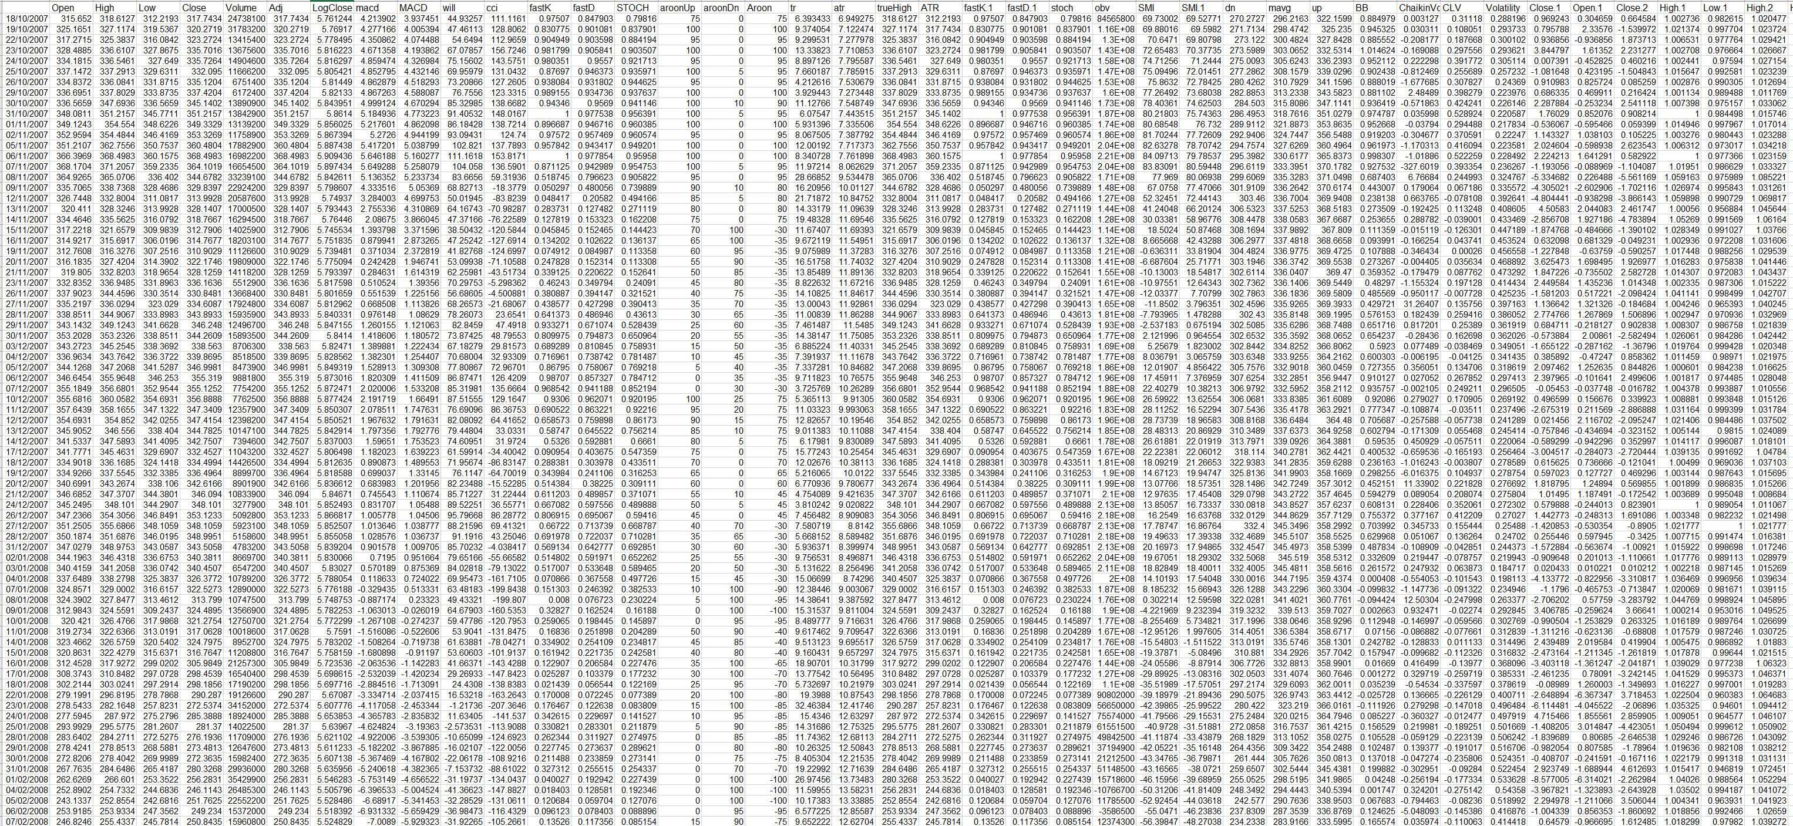

Slide 9
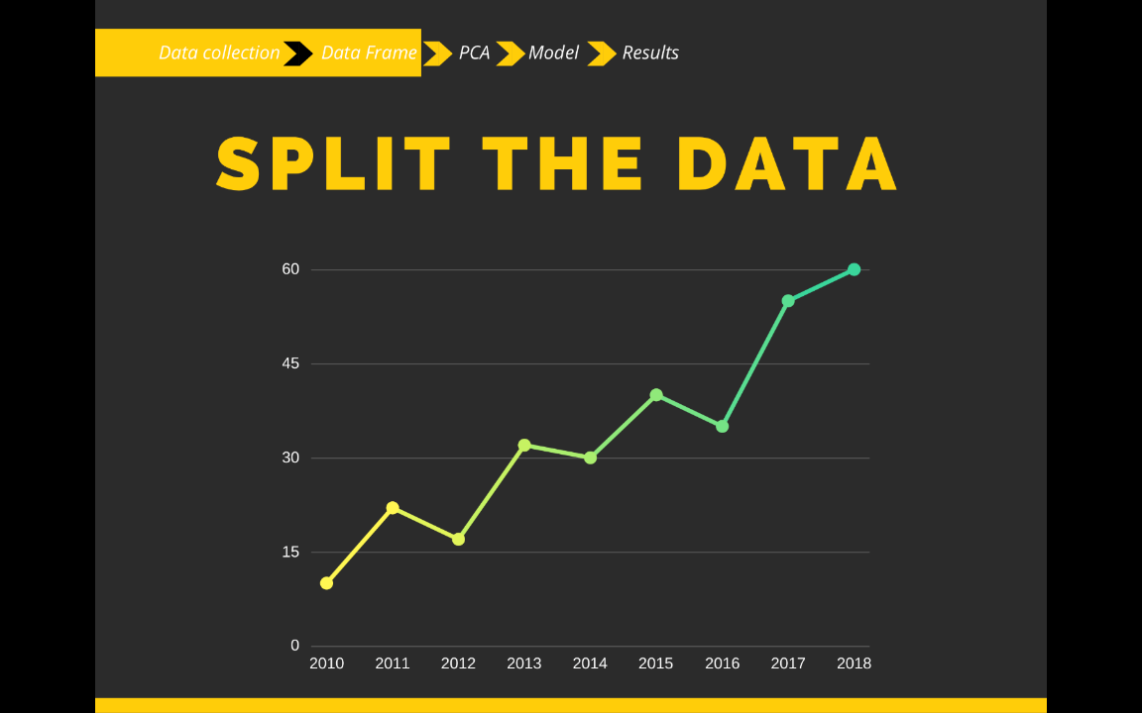


Slide 11
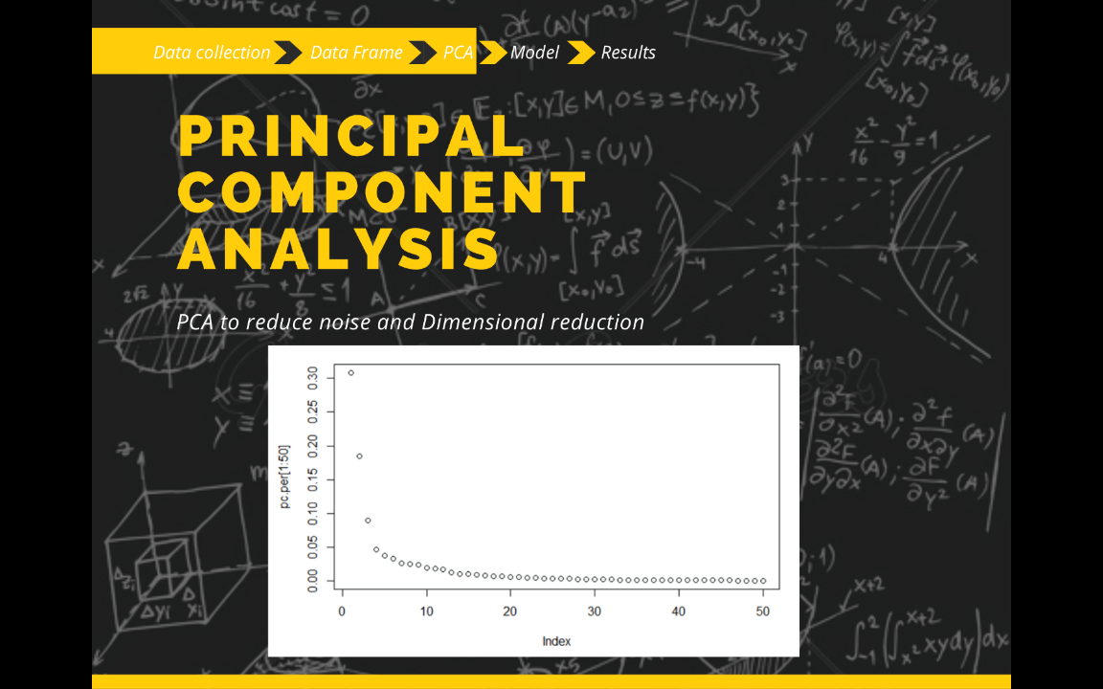
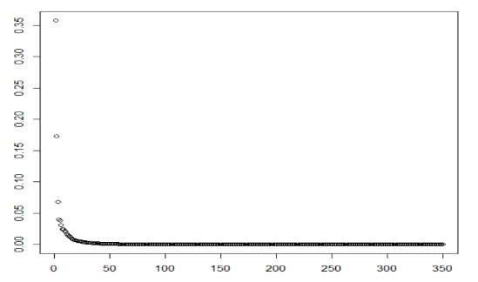
97%

Slide 12





1 Day Prediction |  | Classification Results
Stock | Model | Accuracy | Precision | Recall
HOG | RF | 0.49 | 0.84 | 0.04
FITB | LR | 0.49 | 0.82 | 0.06
USB | RF | 0.47 | 0.80 | 0.02
LYB | LR | 0.50 | 0.78 | 0.06

Slide 13
30 Day Prediction |  | Classification Results
Stock | Model | Accuracy | Precision | Recall
HST | LR | 0.51 | 0.80 | 0.19
ATVI | GBM | 0.61 | 0.75 | 0.70
JPM | GBM | 0.46 | 0.75 | 0.43
CHTR | LR | 0.35 | 0.70 | 0.29

Slide 14
60 Day Prediction |  | Classification Results
Stock | Model | Accuracy | Precision | Recall
HST | LR | 0.47 | 0.77 | 0.26
ATVI | RF | 0.49 | 0.75 | 0.48
HST | RF | 0.44 | 0.70 | 0.26
MNST | RF | 0.50 | 0.69 | 0.49

Slide 15


Slide 16
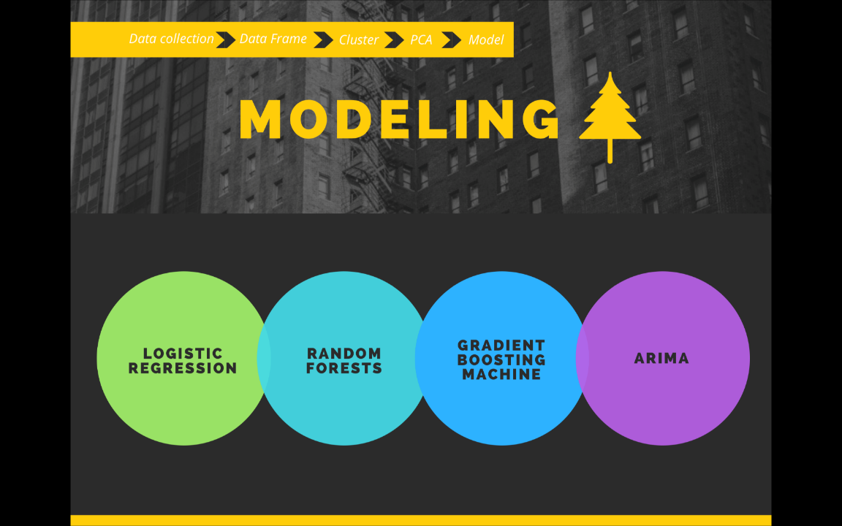

Slide 17
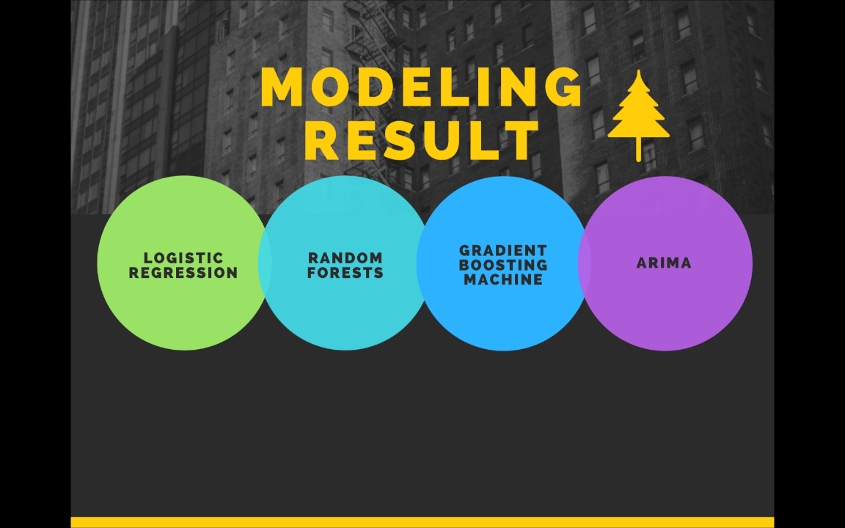
S | A | P | R
Tomorrow Predict
Tomorrow Predict
Tomorrow Predict

Slide 18

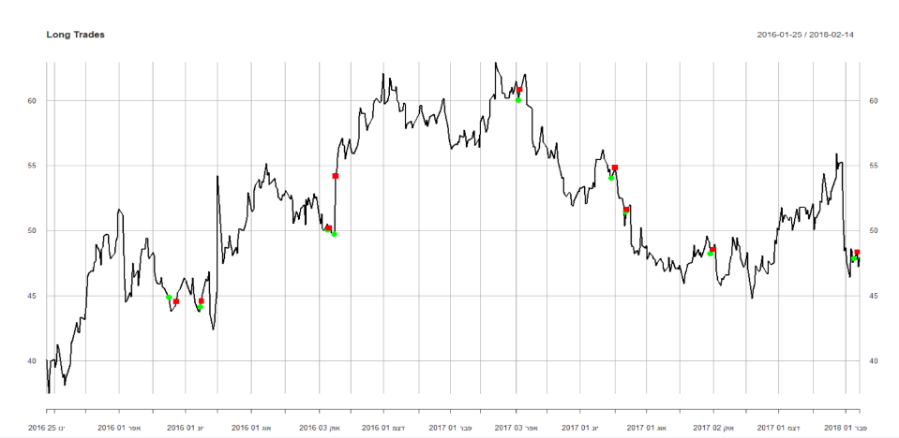
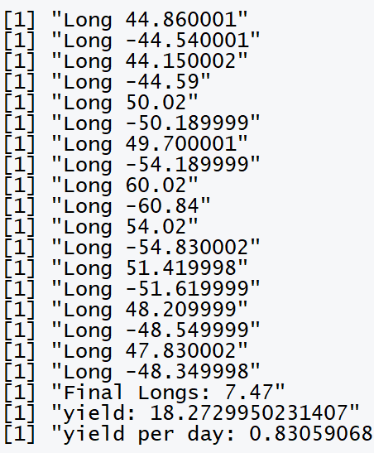
1 Day Prediction |  | Classification Results
Stock | Model | Accuracy | Precision | Recall
HOG | RF | 0.49 | 0.84 | 0.04

Slide 19
Return per day 0.49

Slide 20
Return per day 0.49
Return per day 0.08

Slide 21
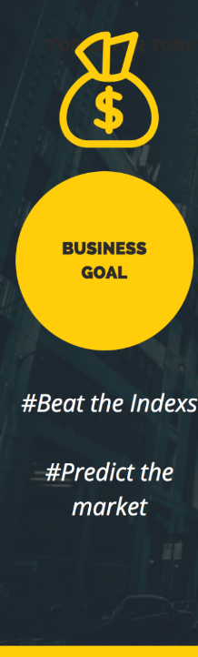


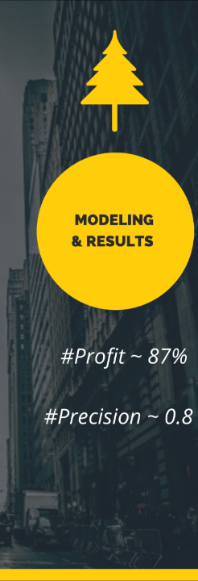


Slide 22






Slide 24


Slide 25
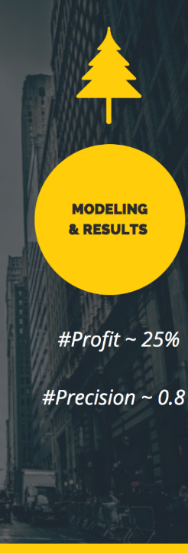

Slide 27


Slide 30
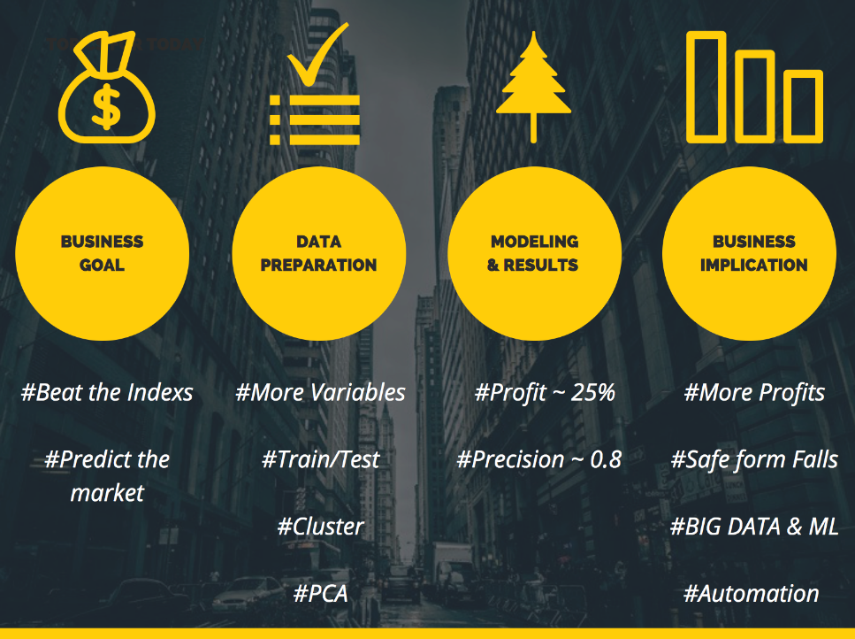

Slide 31
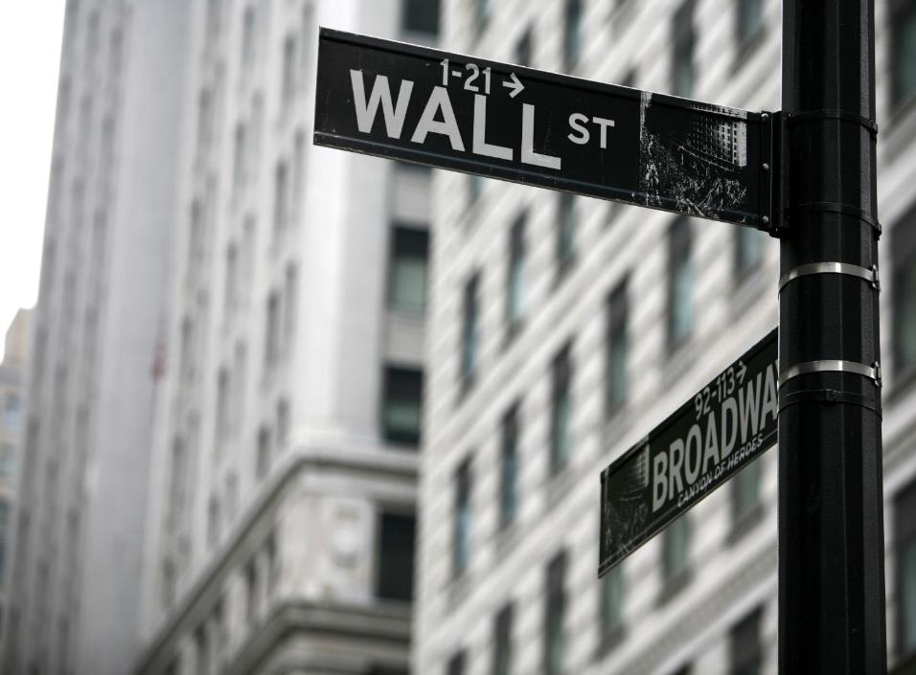
Ori Dahari - oridahari@gmail.com
Eyal Gat - eyaline222@gmail.com
Mor Anavi - moranavi1234@gmail.com

Slide 32


